Slide 1
CSE214 – Analysis of Algorithms
PhD Furkan Gözükara, Toros University https://github.com/FurkanGozukara/Analysis-of-Algorithms-2019
Lecture 11
Complexity Classes (P, NP) (Polynomial, Nondeterministic Polynomial, and Beyond)
Based on Andrew Davison’s Lecture Notes - Prince of
Songkla University (PSU)

Slide 2
Objective
  look at the complexity classes P, NP,
  NP-Complete, NP-Hard, and undecidable problems

Slide 3
Overview
A Decision Problem
Polynomial Time Solvable (P)
Nondeterministic Polynomial (NP)
Nondeterminism
P = NP : the BIG Question
NP-Complete
The Circuit-SAT Problem
NPC and Reducibility
NP-Hard
Approximation Algorithms
Decidable Problems
Undecidable Problems
Computational Difficulty
Non-Technical P and NP

Slide 4
1. A Decision Problem
The problems in the P, NP, NP-Complete complexity classes (sets) are all decision problems
A decision problem is one where the solution is a yes or no
  e.g. is 29 a prime number?

Slide 5
2. Polynomial Time Solvable (P)
The P set contains problems that are solvable in polynomial-time
  the algorithm has running time O(n^{k}) for some constant k.
  Polynomial times: O(n²), O(n³), O(1), O(n log n)
  Not polynomial: O(2^{n}), O(n^{n}), O(n!)
e.g. testing if a number is prime runs in O(n) time
P problems are called tractable because of their polynomial running time.

Slide 6
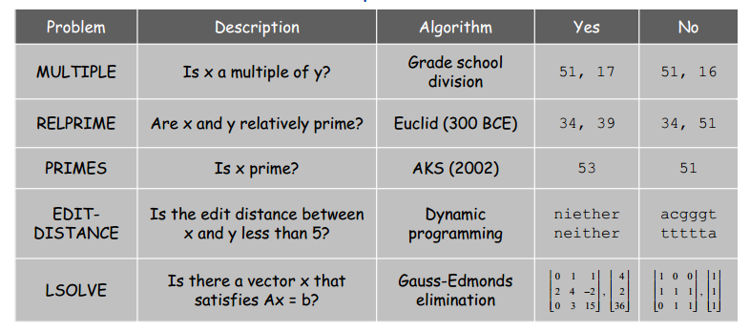
P Examples

Slide 7
3. Nondeterministic Polynomial (NP)
NP is the set of problems that
  can be checked by a polynomial time algorithm
  but can (or might) not be calculated/solved in polynomial time
Most people believe that the NP problems are not polynomial time solvable (written as P ≠ NP)
  this means "cross out the might"
Algorithms to solve NP problems require exponential time, or greater
  they are intractable

Slide 8
P and NP as Sets
Easily checkable problems
e.g. prime factorization
NP
P
Easily solvable problems
P = NP
or P ≠ NP
e.g. multiplication, sorting,
prime testing

Slide 9
Computational Difficulty Line
=?
computational
difficulty
(or hardness)
P
NP

Slide 10
3.1. Factorization is in NP
Prime Factorization is the decomposition of a composite number into prime divisors.
  24 = 2 x 2 x 2 x 3
  91 = 7 x 13
This problem is in NP, not P
    It is not possible to find (solve) a prime factorization of a number in polynomial time
  But given a number and a set of prime numbers, we can check if those numbers are a factorization by multiplication, which is a polynomial time operation

Slide 11
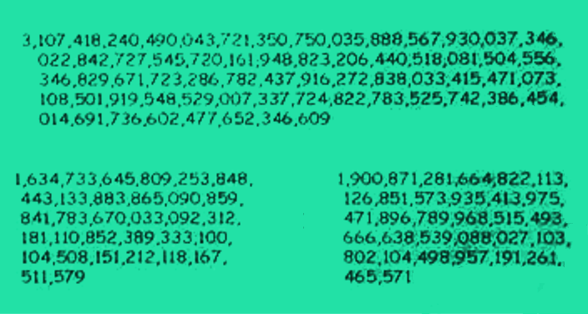
A Bigger Example
? x ? =
Answer is:
X

Slide 12
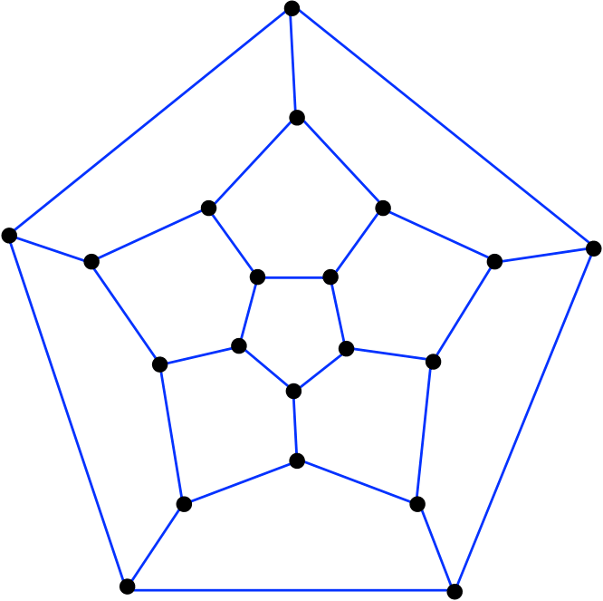
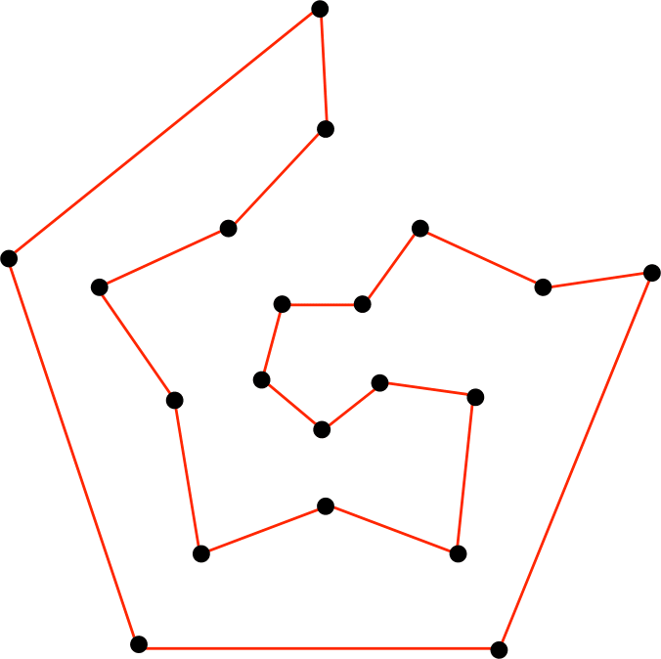
3.2. HC: Another NP Example
Is there a Hamiltonian Cycle in a graph G ?
A Hamiltonian cycle of an undirected graph contains every vertex exactly once.
find a HC

Slide 13
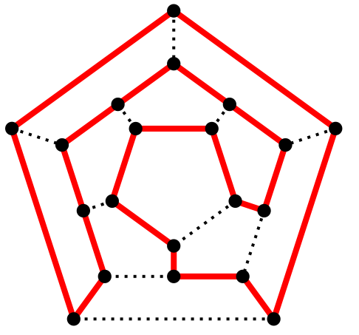
A Hamiltonian cycle is a closed loop on a graph where every node (vertex) is visited exactly once.
A loop is just an edge that joins a node to itself; so a Hamiltonian cycle is a path traveling from a point back to itself, visiting every node en route.
There isn’t any equation or general trick to finding out whether a graph has a Hamiltonian cycle; the only way to determine this is to do a complete and exhaustive search, going through all the options.

Slide 14
Finding a HC
How would an algorithm find an Hamiltonian cycle in a graph G?
  One solution is to list all the permutations of G's vertices and check each permutation to see if it is a Hamiltonian cycle.
What is the running time of this algorithm?
  there are |V|! possible permutations, which is an exponential running time
So the Hamiltonian cycle problem is not polynomial time solvable.

Slide 15
Checking a HC
But what about checking a possible solution?
  You are given a set of vertices that are meant to form an Hamiltonian cycle
  Check whether the set is a permutation of the graph's vertices and whether each of the consecutive edges along the cycle exists in the graph
  Deciding whether a graph G has a Hamiltonian cycle is not polynomial time solvable but is polynomial time checkable, so is in NP.

Slide 16
4. Nondeterminism
A deterministic algorithm behaves predictably.
  When it runs on a particular input, it always produces the same output, and passes through the same sequence of states.
A nondeterministic algorithm has two stages:
  1. Guessing (in nondeterministic polynomial time by generating guesses that are always correct)
    The (magic) process that always make the right guess is called an Oracle.
  2. Verification/checking (in deterministic polynomial time)

Slide 17
Example (Searching)
Is x in the array A: (3, 11, 2, 5, 8, 16, …, 200 )?
Deterministic algorithm
  for i=1 to n
  if (A[i] == x) then { print i; return true }
  return false
Nondeterministic algorithm
  j = choice (1:n) // choice is always correct
  if (A[j] == x) then { print j; return true }
  return false
  // since j must be correct if A[] has x

Slide 18
Oracle as Path Finder
Another way of thinking of an Oracle is in terms of navigating through a search graph of choices
  at each choice point the Oracle will always choose the correct branch which will lead eventually to the correct solution

Slide 19
P and NP and Determinism
P is the set of decision problems that can be solved by a deterministic algorithm in polynomial time
NP is the set of decision problems that can be solved by a nondeterministic algorithm in polynomial time
Deterministic algorithms are a 'simple' case of nondeterministic algorithms, and so P ⊆ NP
  simple because no oracle is needed

Slide 20
No one knows how to write a nondeterministic polynomial algorithm, since it depends on a magical oracle always making correct guesses.
So in the real world, the solving part of every NP problem has exponential running time, not polynomial.
But if someone discovered/implemented an oracle, then NP would becomes polynomial, and P = NP
  this is the biggest unsolved question in computing

Slide 21
5. P = NP : the BIG Question
On balance it is probably false (i.e. P ≠ NP)
Why?
  you can't engineer perfect luck
  and
  generating a solution (along with evidence) is harder than checking a possible solution

Slide 22
One Possible Oracle
One possible way to write an oracle would be to use a parallel computer to create an infinite number of processes/threads
  have one thread work on each possible guess at the same time
  the "infinite" part is the problem
Perhaps solvable by using quantum computing or DNA computing (?)
  (but probably not)

Slide 23
Clay Millennium Prize Problems
P = NP Problem
Riemann Hypothesis
Birch and Swinnerton-Dyer Conjecture
Navier-Stokes Problem
Poincaré Conjecture ☑
  solved by Grigori Perelman; declined the award in 2010
Hodge Conjecture
Yang-Mills Theory
each one is worth US $1,000,000

Slide 24
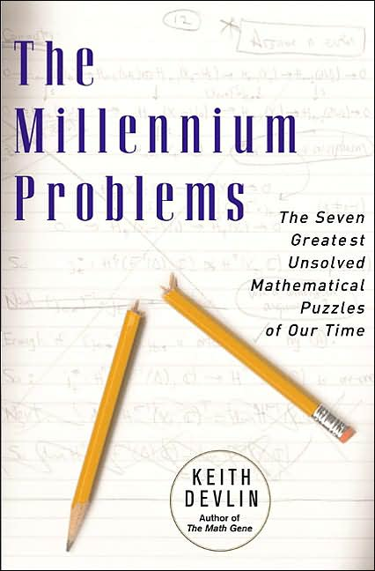
Two Clay Institute videos
  http://claymath.msri.org/tate2000.mov
  Riemann hypothesis, Birch and Swinnerton-Dyer Conjecture, P vs NP
  http://claymath.msri.org/atiyah2000.mov
  Poincaré conjecture, Hodge conjecture,
  Quantum Yang-Mills problem,
  Navier-Stokes problem
A popular maths book about the
problems:
  The Millennium Problem
  Keith J. Devlin
  Basic Book, 2003
  (17 min video): http://profkeithdevlin.com/Movies/MillenniumProblems.mp4

Slide 25
6. NP-Complete
A problem is in the NP-Complete (NPC) set if it is in NP and is at least as hard as other problems in NP.
Some NPC problems:
  Hamiltonian cycle
  Path-finding (Traveling salesman)
  Cliques
  Map (graph, vertex) coloring
  subset sum
  Knapsack problem
  Scheduling
  Many, many more ...
same hardness or harder

Slide 26
Computational Difficulty
=?
computational
difficulty
NP-complete
P
Hamiltonian cycle, TSP,
Knapsack, Tetris, ...
NP

Slide 27
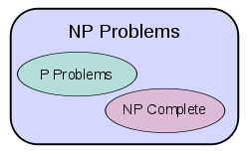
Drawing P, NP, NPC as Sets
P ≠ NP
or
all problems together
in one P set
P = NP (= NPC)

Slide 28
6.1. Travelling Salesman (TSP)
2
1
2
1
3
4
1
3
5
4
4
2
1
2
2
2
2
1
1
1
The salesperson must make a minimum cost circuit, visiting each city exactly once.

Slide 29
A solution (distance = 23):
2
2
1
3
1
1
4
1
3
5
4
4
2
1
2
2
2
1
2
1
1

Slide 30
TSPs (and variants) have enormous practical importance
Lots of research into good approximation algorithms
Recently made famous as a DNA computing problem

Slide 31
6.2. 5-Clique
Set of vertices such that they all connect to each other.

Slide 32
K-Cliques
A K-clique is a set of K nodes connected by all the possible K(K-1)/2 edges between them
This graph contains a 3-clique and a 4-clique

Slide 33
K-Cliques
Given: (G, k)
Decision problem: Does G contain a k-clique?
Brute Force
  Try out all {n choose k} possible locations for the k clique

Slide 34
6.3. Map Coloring
Can a graph be colored with k colors such that no adjacent vertices are the same color?

Slide 35
6.4. Subset Sum
Given a set of integers, does there exist a subset that adds up to some value T?
Example: given the set {−7, −3, −2, 5, 8}, is there a non-empty subset that adds up to 0.
Yes: {−3, −2, 5}
Can also be thought of as a special case of the knapsack problem

Slide 36
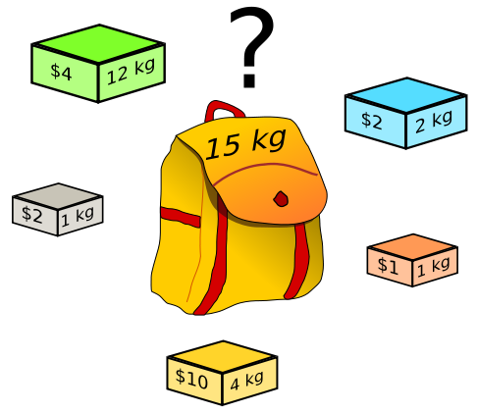

6.5. The Knapsack Problem
The 0-1 knapsack problem:
  A tourist must choose among n items, where the ith item is worth v_{i} dollars and weighs w_{i} pounds
  Carry at most W kg, but make the value maximum
  Example : 5 items: x1 – x5,
  values = (4, 2, 2, 1, 10}
  weights = {12, 2, 1, 1, 4},
  W = 15, maximize total value
x1
x2
x4
x3
x5

Slide 37
Pseudocode
n items
  def knapsack(items, maxweight):
  best = {}
  bestvalue = 0
  for s in allPossibleSubsets(items):
  value = 0
  weight = 0
  for item in s:
  value += item.value
  weight += item.weight
  if weight <= maxweight:
  if value > bestvalue:
  best = s
  bestvalue = value
return best
2^{n} subsets
O(n) for
each one
Running time is O(n⋅2^{n})

Slide 38
The bounded knapsack problem removes the restriction that there is only one of each item, but restricts the number of copies of each kind of item
The fractional knapsack problem:
  the thief can take fractions of items
  e.g. the thief is presented with buckets of gold dust, sugar, spices, flour, etc.

Slide 39
6.6. Class Scheduling Problem
We have N teachers with certain time restrictions, and M classes to be scheduled. Can we:
  Schedule all the classes?
  Make sure that no two teachers teach the same class at the same time?
  No teacher is scheduled to teach two classes at once?

Slide 40
6.7. Why study NPC?
Most interesting problems are NPC.
If you can show that a problem is NPC then:
  You can spend your time developing an approximation algorithm rather than searching for a fast algorithm that solves the problem exactly
  or you can look for a special case of the problem, which is polynomial

Slide 41
More NPC Problems
There are over 3000 known NPC problems.
Many of the major ones are listed at:
  http://en.wikipedia.org/wiki/List_of_np_complete_problems
The list is divided into several categories:
  Graph theory, Network design, Sets and partitions, Storage and retrieval, Sequencing and scheduling, Mathematical programming, Algebra and number theory, Games and puzzles, and Logic

Slide 42
Another way of classifying NPC problems:
  Packing problems: SET-PACKING, INDEPENDENT SET
  Covering problems: SET-COVER, VERTEX-COVER
  Constraint satisfaction problems: SAT, 3-SAT
  Sequencing problems: HAMILTONIAN-CYCLE, TSP
  Partitioning problems: 3D-MATCHING 3-COLOR
  Numerical problems: SUBSET-SUM, KNAPSACK

Slide 43
Hard vs Easy
There's often not much difference in appearance between hard problems and easy ones:
Hard Problems (NP-Complete) | Easy Problems (in P)
SAT, 3SAT | 2SAT
Traveling Salesman Problem | Minimum Spanning Tree
3D Matching | Bipartite Matching
Knapsack | Fractional Knapsack

Slide 44
7. The Circuit-SAT Problem
Almost the first problem to be proved NPC
  Cook 1971, Levin 1973
  actually Cook proved SAT was in NPC, but Circuit-SAT is almost the same, and is the example used in CLRS
What did Cook do?
Remember: a problem is in NPC if
  it is in NP and
  it is at least as hard as other problems in NP
same hardness or harder

Slide 45
What is Circuit-SAT?
The Circuit-Satisfiability Problem (Circuit-SAT) is a circuit composed of AND, OR, and NOT gates.
A circuit is satisfiable if there exists a set of boolean input values that makes the output of the circuit equal to 1.

Slide 46
A Circuit
Logic Gates
1
0
0
1
1
NOT
1
1
0
OR
1
1
0
0
1
AND

Slide 47
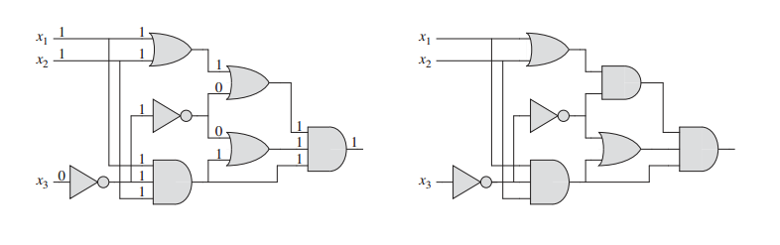
Satisfiablity Examples
No 1 is
possible
(a) Satisfiable
(a) Unsatisfiable
Circuit (a) is satisfiable since
<x1, x2, x3> = <1, 1, 0> makes the output 1.

Slide 48
Part 1. Circuit-SAT is NP
If there are n inputs, then there are 2^{n} possible assignments that need to be tried in order to find a solution
  solving is O(2^{n}), exponential running time
Testing a solution is done by evaluating the circuit's logical expression which can be done in linear running time
  testing is O(n), polynomial running time

Slide 49
Part 2. Circuit-SAT is NPC
Cook’s Theorem
  it proves (Circuit-) SAT is NPC from first principles, based on its implementation of the Turing machine
All other problems have been shown to be NPC by reducing (transforming) Circuit-SAT into those problems (either directly or indirectly)

Slide 50
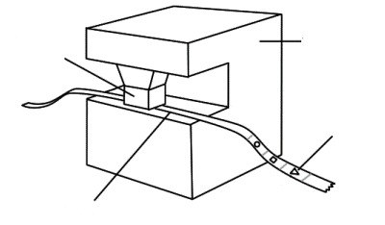
What's a Turing Machine?
A Turing machine is a theoretical device composed of an infinitely long tape with printed symbols representing instructions.
The tape can move backwards and forwards in the machine, which can read the instructions and write results back onto the tape.
sensor to read,
write, or erase
machine with
finite number
of states
symbols on tape
moving tape

Slide 51
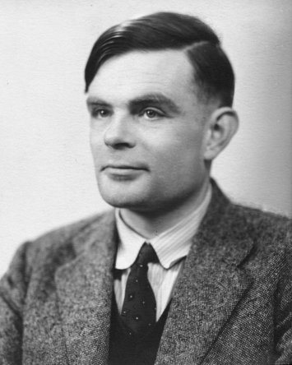
Invented in 1936 by Alan Turing.
Despite its simplicity, a Turing machine can simulate the logic of any computing machine or algorithm.
  i.e. a function is algorithmically computable if and only if it is computable by a Turing machine
  called the Church–Turing thesis (hypothesis)

Slide 52
Algorithms & Turing Machines
Any algorithm can be implemented as a Turing machine
  this is how "computable" is formally defined
Every problem in NP can be transformed into a program running on a (non-deterministic) Turing machine. (Church-Turing)
  "non-deterministic" means that the finite state machine used by the Turing machine is non-deterministic

Slide 53
Back to Cook's Theorem
Cook's Theorem argues that every feature of the Turing machine, including how instructions are executed, can be written as logical formulas in a satisfiability (SAT) problem. (cook 1)
So any a program executing on a Turing machine can be transformed into a logical formula of satisfiability. (cook 2)

Slide 54
Combining Church-Turing and cook 2 means that every problem in NP can be transformed into a logical formula of satisfiability. (cook 3)
This means that the SAT problem is at least as hard as any problem in NP (cook 4)
By definition, a problem is in NPC if it is in NP and is at least as hard as other problems in NP
  so (Circuit-) SAT is in NPC
same hardness or harder

Slide 55
Cook's Theorem as Pictures
TM's tape
. . .
. . .
A
x
y
solution
data y
problem x
an algorithm A for
checking the solution
data y against
problem x in
polynomial time
Turing Machine TM
for executing A on x
and y in polynomial
time
polynomial
time
translation
YES/NO
TM ≈ simulation of
a simple computer

Slide 56
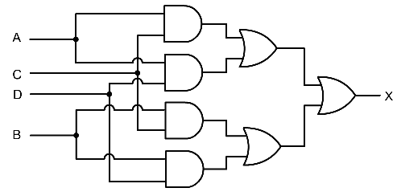
binary inputs (...101011000...)
representing A, x and y
TM's tape
. . .
. . .
A
x
y
Turing Machine TM
for executing A on x
and solution data y
in polynomial time
polynomial
time
translation
Circuit-SAT C
TM ≈ simulation of
a simple computer
C ≈ a simple
real computer
output of 1 means A
has checked the y against x

Slide 57
Informal Explanation
The Turing Machine runs the program A (run-time software) against the input x (program) and the solution data y (program's input).
This Turing machine can be implemented as a Circuit-SAT 'computer' made up of AND, OR, and NOT gates.
Since Circuit-SAT can implement any problem (i.e. the A, x, and y) then it is as least as hard (complex) as any other problem, and so is NP-Complete.

Slide 58
8. NPC and Reducability
A formal definition of NPC requires the reducibility of one problem into another.
If we can reduce (transform) a problem S into a problem L in polynomial time, then S is not polynomial factor harder than L
  this is written as : S ≤p L
Harder means "bigger running time"

Slide 59
Is a Problem 'L' in NPC?
First show that the problem L is in NP
  show that it can be solved in exponential time
  Show that it can be checked in polynomial time
Show how to reduce (transform) an existing NPC problem S into L (in polynomial time)
  S is NPC
  S ≤_{p} L
  Then L is NPC
A known NPC problem S
A problem L to be proved NPC
reduce

Slide 60
This reduction means that the existing NPC problem (S) is no harder than the new problem L
  harder means "bigger running time"
This hardness 'link' between NPC problems means that all NPC problems have a similar (or smaller) hardness, and that all NP problems are less hard.
If a researcher proves that any NPC problem can be solved in polynomial time, then all problems in NPC and NP must also have polynomial running time algorithms.
  in other words P = NP

Slide 61
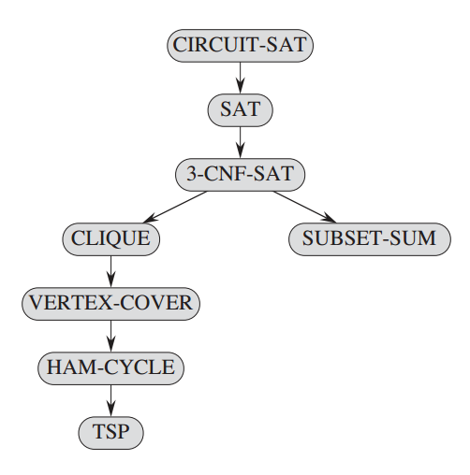
Proving Problems are NPC
use
reductions

Slide 62
8.1. The Satisfiability Problem (SAT)
Given a Boolean expression on n variables, can we assign values such that the expression is TRUE?
Example:
  (x₁ →x₂) ∨ ¬((¬x₁ ↔ x₃) ∨ x₄)) ∧¬x₂
A satisfying truth assignment:
  <x1, x2, x3, x4 > = <0, 0, 1, 1>

Slide 63
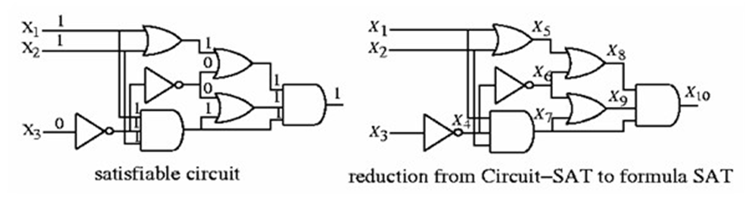
Reduction Graphically
with additional 'gate' variables
  φ = x10 ∧ (x4 ↔ ¬ x3) ∧ (x5 ↔(x1∨ x2)) ∧ (x6 ↔ ¬ x4) ∧
  (x7 ↔(x1∧ x2 ∧ x4)) ∧ (x8 ↔(x5 ∨ x6)) ∧(x9 ↔(x6 ∨ x7)) ∧
  (x10 ↔ (x7 ∧ x8 ∧ x9))

Slide 64
Is SAT a NPC Problem?
SAT is an NP problem.
Prove that Circuit-SAT ≤_{P} SAT
  remember the left-hand-side must be an existing NPC problem

Slide 65
8.2. The 3-SAT Problem
3SAT: the Satisfiability of boolean formulas in
3-conjunctive normal form (3-CNF).
3SAT is NP
Show that 3SAT is NPC by proving SAT ≤_{P} 3SAT.

Slide 66
Conjunctive Normal Form (CNF)
A Boolean formula is in conjunctive normal form if it is an AND of clauses, each of which is an OR of literals
  e.g. (x₁ ∨ ¬x₂) ∧ (¬x₁ ∨ x₃ ∨ x₄) ∧ (¬x₅)
3-CNF: each clause has exactly 3 distinct literals
  e.g. (x₁ ∨ ¬x₂ ∨ ¬x₃) ∧ (¬x₁ ∨ x₃ ∨ x₄) ∧ (¬x₅ ∨ x₃ ∨ x₄)
  Note: the formula is true if at least one literal in each clause is true

Slide 67
9. NP-Hard
A NP-Hard problem is at least as hard as the hardest problems in NP (i.e. NPC problems).
A NP-Hard problem may not have a polynomial time checking algorithm
  that makes those NP-hard problems harder to solve than NPC problems
  e.g. the halting problem: "given a program and its input, will it run forever?"
  e.g. chess: "will black or white win from a given board configuration?"

Slide 68
Computational Difficulty
NP-hard
=?
computational
difficulty
NP-complete
P
Tetris, etc.
chess
halting
problem
NP

Slide 69
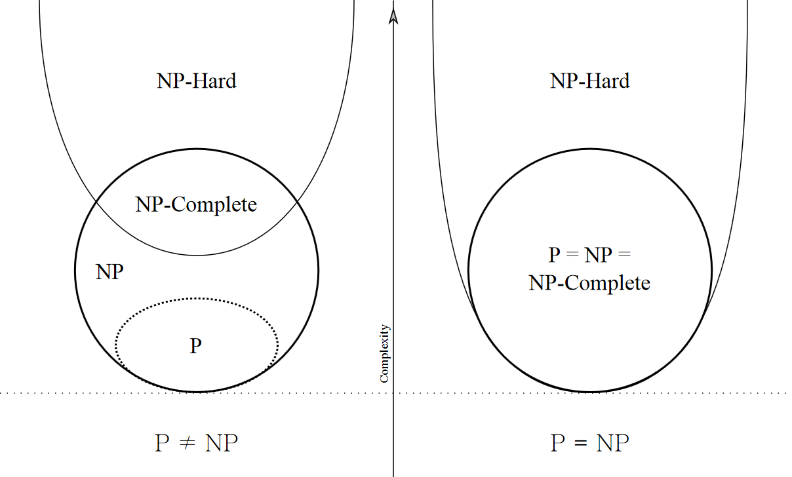
Drawing P, NP, etc. as Sets
Even if P = NP,
NP-Hard can be harder

Slide 70
Coping with NPC/NP-Hard Problems
Approximation algorithms:
  guarantee to be a fixed percentage away from the optimum
Pseudo-polynomial time algorithms:
  e.g., dynamic programming for the 0-1 Knapsack problem
Probabilistic algorithms:
  assume some probabilistic distribution of the data
Randomized algorithms:
  use randomness to get a faster running time, and allow the algorithm to fail with some small probability
  e.g. Monte Carlo method, Genetic algorithms

Slide 71
Restriction: work on special cases of the original problem which run better
Exponential algorithms / exhaustive search:
  feasible only when the problem size is small.
Local search:
  simulated annealing (hill climbing)
Heuristics
  use "rules of thumb" that have no formal guarantee of performance

Slide 72
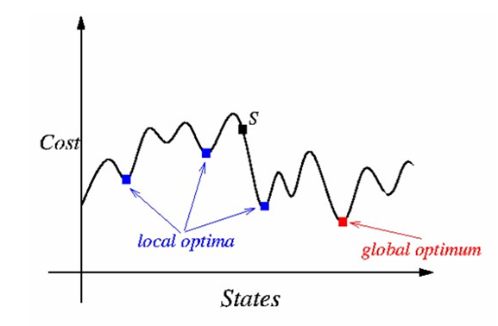
Simulated Annealing
Use probabilities to jump around in a large search space looking for a good enough solution called a local optimum.
By contrast, the actual best solution is the global optimum.

Slide 73
10. Approximation Algorithms
An approximation algorithm is one that returns a near-best solution.
The quality of the approximation can be measured by comparing the 'cost' of the best solution against the approximate one
Cost can be any aspect of the algorithm
  e.g. number of nodes, edge distance, running time, space

Slide 74
10.1. Approx. Algorithm for TSP
Approx-TSP-Tour(G)
select a vertex from G to be a “root”
grow a minimum spanning tree (MST) for G from root r using Prim()
create a list L of vertices visited in a preorder tree walk over the MST
return Hamiltonian cycle using L for its order
Time complexity: O(V log V).

Slide 75
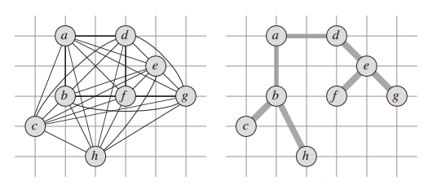
Approx-TSP Example
an integer unit grid
Undirected
Graph
(b) MST created
with Prim()

Slide 76
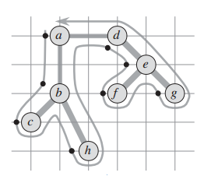
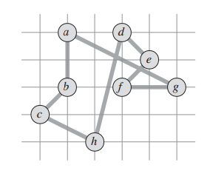
Preorder walk: a, b, c, b, h, b, a, d, e, f, e, g, e, d, a
(c) Preorder walk
over the MST
A preorder walk that lists a vertex only when it is first encountered, as indicated by the dot next to each vertex:
a, b, c, h, d, e, f, g
(d) Tour using
the preorder
MST.
Cost of tour: ~19.074
(by measuring squares)

Slide 77
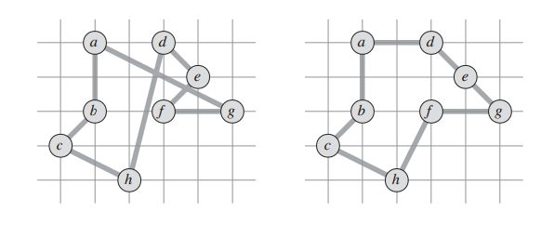
What are we Comparing?
We want to compare an optimal tour with a tour using a preorder MST. For this example:
Tour using the preorder MST
Optimal Tour
Cost of tour: ~19.074
Cost of tour: ~14.715

Slide 78
11. Decidable Problems
Decidable problems are often split into three categories:
  Tractable problems (polynomial)
  NPC problems
  Intractable problems (exponential)
    sometimes grouped in the set EXP
All of the above have algorithmic solutions, even if they have impractical running times.
  All of these are placed in a group called R
  R = {set of problems solvable in finite time}

Slide 79
12. Undecidable Problems
An undecidable problem is one where it is impossible to construct an algorithm that gives a correct yes-or-no answer.
Instead:
  the answer may be wrong, or
  no answer may appear, no matter how long you wait

Slide 80
Computational Difficulty
NP-hard
=?
=?
EXP-hard
computational
difficulty
NP-complete
EXP-complete
P
tetris, etc
chess
halting
problem
NP
EXP
R
decidable
undecidable

Slide 81
12.1. The Halting Problem
Decide whether a given program with some input finishes, or runs forever.
The halting problem is undecidable.
  an algorithm to solve the halting problem for all possible program-input pairs does not exist

Slide 82
Isn't detecting halting easy?
No. It can be very difficult.
e.g. Does this code finish for every possible input?
    read n;
    while(n != 1) {
    if (even(n))
    n = n/2;
    else
    n = 3*n + 1;
    print n;
    }

Slide 83
The maths behind this function is known as the Collatz conjecture (unsolved problem).
  The conjecture: no matter what positive number you start with, the function will eventually reach 1.
Examples
  start with n = 6, the sequence is 6, 3, 10, 5, 16, 8, 4, 2, 1.
  n = 11, sequence is 11, 34, 17, 52, 26, 13, 40, 20, 10, 5, 16, 8, 4, 2, 1
  called hailstone sequences

Slide 84
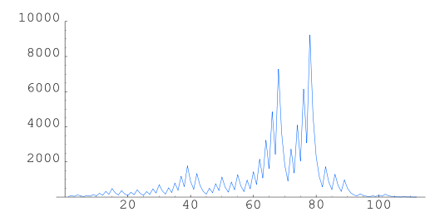
The sequence for n = 27, loops 111 times, climbing to over 9000 before descending to 1

Slide 85
Why the Halting Problem is Undecidable
Let's assume the halt(String p, String i) function implements the halting problem.
  It takes two inputs, an encoded representation of a program as text (p) and the program's input data (i).
halt() return true or false depending on whether p halts when executing the i input.
p halts on i
true
p
halt()
or
i
p does not
halt on i
false

Slide 86
Examples
halts(“def sqr(x): return x * x", "sqr(4)")
returns true
halts(“def fac(n):
if (n == 0) return 1
else return n * fac(n-1)", "fac(10)”)
returns true
halts(“def foo(n):
while (true) { n = n + 1}", "foo(4)")
returns false

Slide 87
Now for Trouble
Let's create a 2nd function called trouble(String q).
It creates two copies of its input q, and passes them to halt().
  trouble(q) calls halt(q, q)
This means that q is both the program and its data in halt()

Slide 88
Implementing trouble()
If halt(q,q) outputs false, then trouble() returns true and finishes.
If halt(q,q) outputs true, then trouble() goes into an unending loop (and thus does not finish).
halt(q,q) is
false
true; and finishes
q
trouble()
or
never
finishes
halt(q,q) is
true

Slide 89
boolean trouble(String q)
{
if (!halt(q, q))
return true;
else { // halt(q, q) is true
while (true) { // loop forever
// do nothing
}
return false; // execution never gets here
}
}

Slide 90
Double Trouble
The input string q of trouble() can be anything:
  encode the trouble() function as a string called t, and use that as input.
What is the result of trouble(t)?
There are two possibilities: either trouble() returns true (i.e. halts), or loops forever (it does not halt). Let's look at both cases.

Slide 91
Two Cases
1. trouble(t) halts which means that halt(t,t) returned false.
But halt() is saying that trouble(t) does not halt. Contradiction.
2. trouble(t) does not halt which means that halt(t,t) returned true.
But halt() is saying that trouble(t) does halt. Contradiction

Slide 92
Contradictions are Deadly
In both cases, there's a contradiction because of halt().
This means that it is possible to construct an program/input pair for halt() which it processes incorrectly.
This means that there is no halt() algorithm which correctly works for all inputs.
  the Halting Problem is undecidable

Slide 93
12.2. Wang Tiling
In 1961, Wang conjectured that if a finite set of tiles tile the plane, then they can be combined to form a periodic tiling
  i.e. a repeating pattern
But in 1966, Robert Berger proved that no such combination algorithm exists
  he used the undecidability of the halting problem to imply the undecidability of this tiling problem
Wang tiles can only tile the plane aperiodically
  i.e. a pattern never repeats

Slide 94
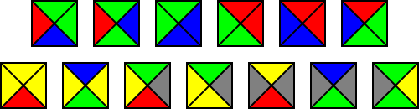
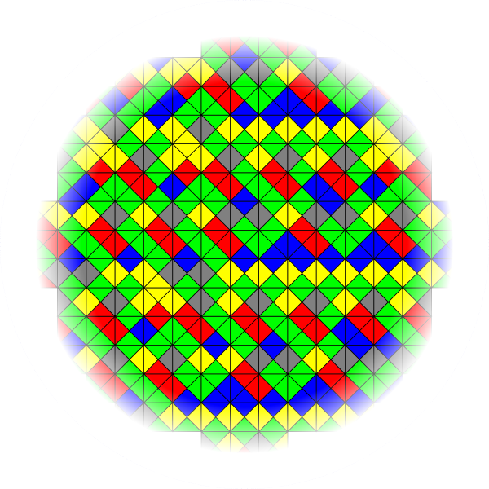
Example
13 Wang tiles that can only tile aperiodically:
Aperiodic example:

Slide 95
Uses
Wang tiles have become a popular tool for procedural synthesis of textures, height fields, and other large, nonrepeating data sets.
  e.g. for decorating 3D gaming scenes

Slide 96
12.3. Other Undecidable Problems
A good list can be found at:
  http://en.wikipedia.org/wiki/List_of_undecidable_problems
The problem categories are mathematical, as you'd expect:
  logic, abstract machines, matrices, combinatorial group theory, topology, analysis, others

Slide 97
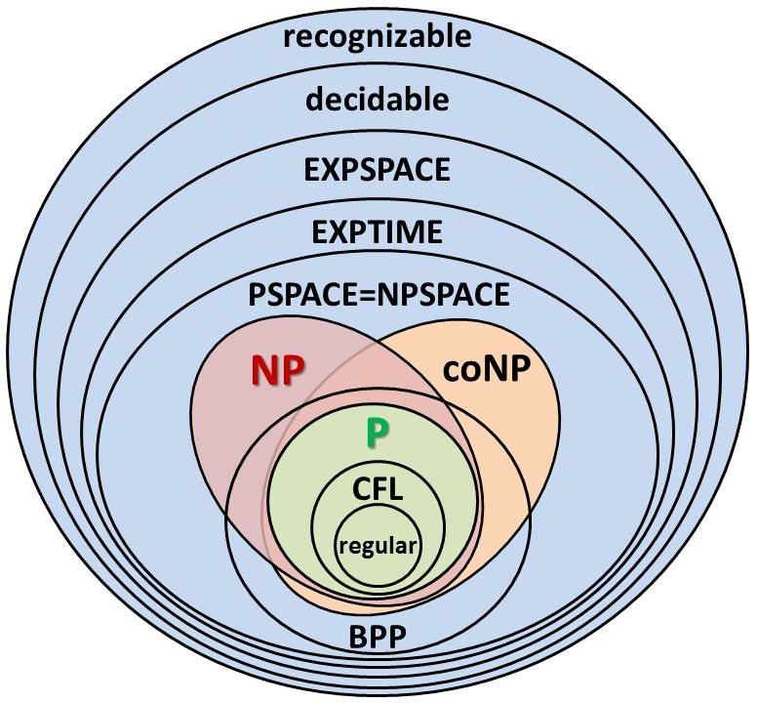
13. Computational Difficulty

Slide 98
What!
Adding memory space and randomization to running time creates new complexity classes
  PSPACE is the set of all decision problems that can be solved using a polynomial amount of space
  EXPSPACE uses an exponential amount of space
  BPP ( bounded-error probabilistic polynomial time)uses a probabilistic algorithm in polynomial time, with an error probability of at most 1/3 for all instances
  NPSPACE is equivalent to PSPACE, because a deterministic Turing machine can simulate a nondeterministic Turing machine without needing much more space.

Slide 99
co-NP is the class of problems for which polynomial checking times are possible for counterexamples of the original NP problem
  A counterexample is where the decision problem is negated, and you find a YES/NO answer for that question.

Slide 100
Complexity Classes
P, NP, NPC, NP-Hard, EXP, R, EXP-Hard, ...
PSPACE, NPSPACE, EXPSPACE, ...
  quite a few complexity classes (sets)
  is that all of them?
No, the "Complexity Zoo" website currently lists 535 classes
  https://complexityzoo.uwaterloo.ca/Complexity_Zoo
But the "petting zoo" only lists 16.

Slide 101
14. Non-Technical P and NP
Video talk "Beyond Computation: The P vs NP Problem"
Michael Sipser, Dept. of Maths, MIT
Oct. 2006
http://www.youtube.com/watch?v=msp2y_Y5MLE

